Slide 1


Slide 2





MEET THE TEAM
ABIMBOLA SANNI
PROJECT MANAGER
BHUPINDER SINGH
ASSITANT PROJECT MANAGER
GEETHU JOY
BUSINESS ANALYST
YASH SURTI
BUSINESS ANALYST
MAHEEP KAUR
BUSINESS ANALYST

Slide 3

ABOUT SCOTIA BANK
Global Presence: Significant operations in the Caribbean, Central and South America, and parts of Asia
Assets and Financial standing: Asset worth over CAD 1 trillion, 3rd Largest bank in Canada. Earned about $ 2.16 billion ($1.69 per share)for Q2 2023
Founded: 1832, Halifax, Nova Scotia
Services: Diverse financial offerings, including retail, commercial, and investment banking, plus wealth management.
CSR: Strong commitments in education, health, and sports.
Digital Innovations: Advanced mobile apps, online platforms, and fintech integration.

Slide 4
Market Expansion
Revenue Generation
Operational Efficiency
Data Analytics
Risk Management
Customer Protection
E
T
L
P
S
E
Regulatory Support
International diplomacy
Customer Satisfaction
Social Integration
Resource Optimization
Corporate sustainability

Slide 5
SWOT
STRENGTH WEAKNESS
SCOTIA
Global presence: US & Canada
Scotia TranXact
Diverse Revenue Streams
BMO
US & Canada
Innov8
Wealth management and financial planning
BMO​
Profitability
Market cap
Limited Local markets
SCOTIA​
19.68% YoY decline
Market cap
Limited domestic focus
Behind TD and BMO
Mexico, Peru, Chile and Colombia
Retail banking & international operations
TD
US & Canada
TD Global transfer and UGO
Insurance.
CIBC
US & Canada
C Suite
Personal & business banking
TD​
Technology Investment
Customer Service Issues
Dependence on US and Canada : Fewer branches
CIBC​
Gap in Technology Investment
Market Share
Cybersecurity Risks

Slide 6
SWOT
OPPORTUNITIES THREATS
BMO
Developing regions
User-friendly interfaces, & novel digital offerings.
innovation & digital banking
BMO​
Competition
Regulatory risk
Economic fluctuations
Customer habits
SCOTIA
Expansion : Latin America
Technology investments
Fintech Partnership
SCOTIA​
Competition
Regulatory risk
Economic fluctuations
Political risks
Cutting-edge technology and user-friendly interfaces.
Block chain
TD
US & other countries
AI, machine learning, data analytics and mobile technology
cost saving and efficiency
TD​
Competition
Government Regulations
Currency Swings
Mortgage and Loan Regulations
CIBC​
Competition
Past Issues
Uncertain Environment
Increased Marketing Efforts
CIBC
North American countries
AI, machine learning, data, and analytics
Cloud Technology

Slide 7
OPPORTUNITY TO EXPLORE
Scotiabank advances with opportunity to leverage cutting-edge UPI technology for payments.
Customer-centric focus for faster transactions appeals to tech-savvy clients.
Enhanced banking experience: seamless border transactions and improved security.
Pre-implementation analysis covers cost-benefit, risks, and compliance.
Strategic implications include technological progress and customer-centric banking.

Slide 8
PROJECT SCOPE
Objective
Goals
Address growing consumer preference for electronic payments.
Ensure a secure and practical payment method.
Benefits
Enhanced customer experience
Competitive advantage
Characteristics
Interoperability: Seamless integration with digital payment platforms.
Security: Strong encryption, authentication, fraud detection.
User Interface: Intuitive design on mobile and web.
Transaction Speed: Lowest latency real-time processing.
User Criteria
Given Scotiabank account and UPI registration.
When user initiates a transaction, validates via authentication.
Then real-time processing, secure encryption, prompt confirmation.
Align with Scotiabank's innovation commitment.
Thrive in evolving financial landscape via UPI adoption

Slide 9

PROJECT CHARTER - UPI
Objectives
Integrate UPI for quick, secure payments.
Success Criteria
Ensure reliable transactions
Reduce costs, expand market presence.
Approach
Assemble diverse team, draft charter
Train, inform, deploy in phases.
Attain financial sector innovation.
Cut costs, boost productivity.
Improve user experience
Plan with risk, communication strategies
Collaborate for UPI design, testing.
Continuous evaluation until closure.
Profile
Budget Information: $5.4 Billion Dollars
Dates: Sep 12 2023 - Sep 23, 2024

Slide 10
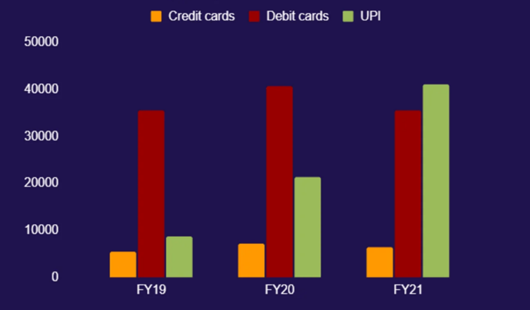
SUMMARY OF SCOTIA UPI
Scotiabank's Strategic Response: Scotiabank offers a giant stride into payment technology that is responding to ever-changing customers tastes
Customer-Centric Benefits: The step by Scotia bank saves time and is compatible which accommodates the high-tech customer that loves fast payments.
Elevating the Banking Experience: Scotiabank is positioned as a pioneer in the field of finances because in addition to improving the banking business as a whole, UPI helps transfers even outside Scotiabank.
Strategic Positioning: As a leading industry player in terms of innovation and efficiency that puts its customers first, Scotiabank sees itself moving ahead with this mission statement.
Key Advantages of Scotia UPI:
Market penetration
Cost-Efficiency
Consumer satisfaction and loyalty.

Slide 11
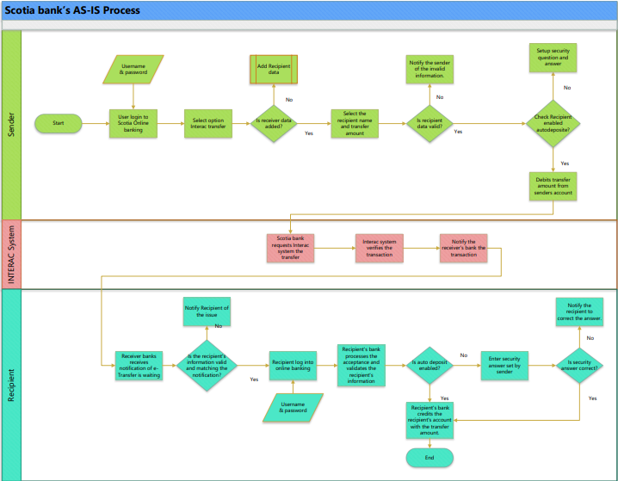
AS-IS PROCESS

Slide 12
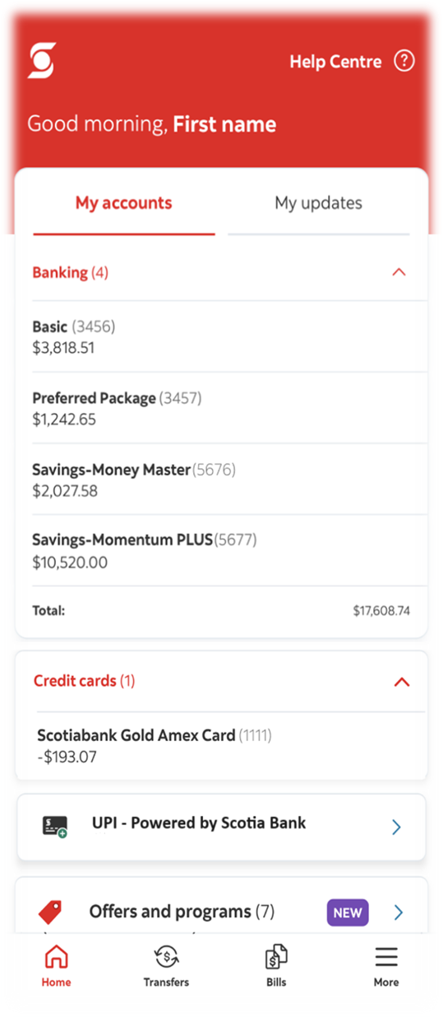
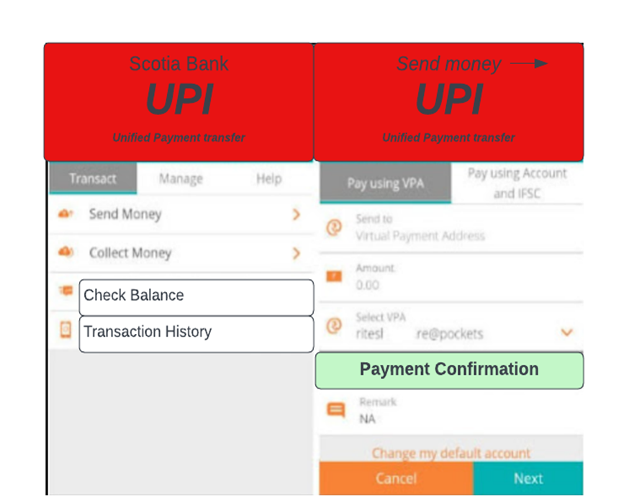
POSSIBLE SOLUTION#1: UPI IN EXISTING MOBILE APP
Verify your two-factor authentication, transaction restrictions, and available cash.
Conform to security and regulatory requirements.
Process of design that includes alerts for successful transactions.
Incorporate timestamps and transaction IDs.
Put in place safe creation and user account linkage.
Interfaces for adding, modifying, and removing VPAs.
Describe the procedures involved in processing transactions.
Incorporate safeguards to ensure the integrity of the money.
Real-time alerting mechanism.

Slide 13
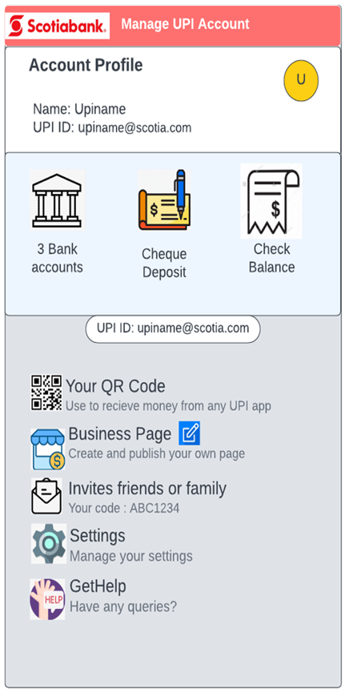
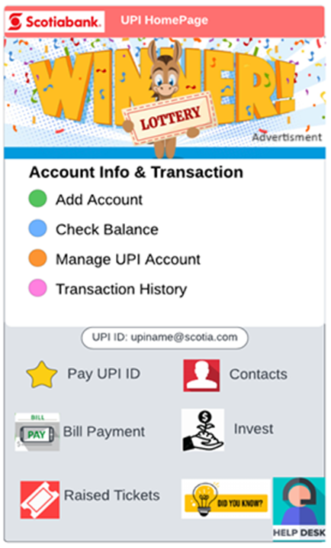
POSSIBLE SOLUTION#2: LAUNCH AN INDEPENDENT UPI APP
User identification and registration: (Creation of User Profiles, Establishing a Secure Password)
Account Information (Manage Account, Transaction History, Balancing Check)
Payment of Bills (Pay Bills, Recurring Payments, Transaction Records Bill, Payment Reminders)
Contacts
Investments
Ticket Raised (Support Ticket System, Ticket Categories, Updates on Status, Alerts, Chat Support)
Authentication and Security (Multi-Factor Authentication, Email Verification)
Offers and Promotions (Promotional Banners, Push Notifications, Event-Based Notifications)

Slide 14
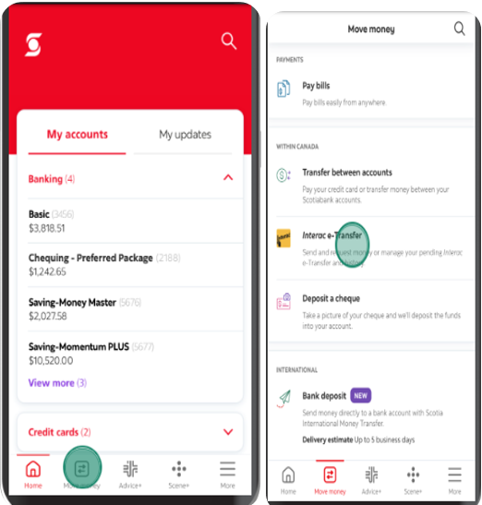
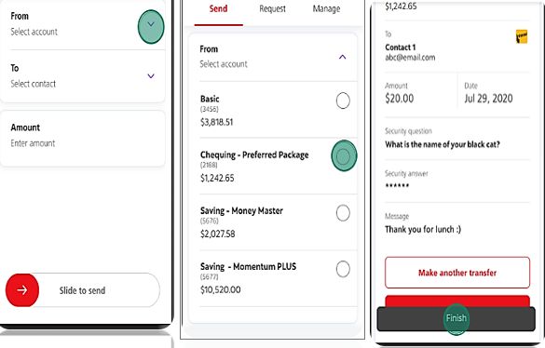
POSSIBLE SOLUTION#3: DO NOTHING
Operational Framework: Scotiabank does not require any changes, updates, or integrations to continue using its present banking system.
Payment Interface: Interac continues to be the major digital payment method; no investigation or adoption of more recent systems, such as UPI, is planned.
Customer Interactions: The channels and platforms that customers use to connect with the bank for digital payments are still mobile banking, online portals, ATMs, and Interac-powered in-branch systems.
Integration with Other Services: There won't be any changes made to any of Scotiabank's current Interac payment system-integrated services, including lending and investing.

Slide 15
MAJOR RISKS AND MITIGATION
Cybersecurity and System Integration
Prioritizing robust cybersecurity measures to protect against data breaches.
Addressing challenges in integrating UPI with existing banking systems.
Compliance with Regulations
Ensuring adherence to financial and data protection regulations across jurisdictions.
Operational Efficiency and Training
Streamlining operations for UPI integration and reducing human error through staff training.
Market Adoption and Competitive Landscape
Developing strategies to enhance customer acceptance of UPI.
Monitoring and responding to competitive actions in the market.
Continuous Risk Monitoring and Budgeting
Implementing a dynamic risk monitoring system with allocated budgets for risk mitigation.

Slide 16
TEST STRATEGY
Comprehensive Testing Stages
Emphasize the sequential stages of testing: Unit, Integration, System, and User Acceptance Testing (UAT), highlighting the focused objectives of each stage.
Diverse Testing Types
Outline the variety of tests: Functional, Performance, Security, Integration, and Regression Testing, to ensure comprehensive coverage of all aspects of the UPI integration.
Roles and Responsibilities
Clarify the roles: Developers (unit testing and defect resolution), Testers (integration to UAT), Project Managers (coordination), and Business Analysts (validating requirements).
Advanced Testing Tools and Environments
Highlight the use of Selenium for UI testing and Jira for test case management, along with testing across multiple environments (Development, Testing, UAT, Production) and devices (iOS and Android).
Risk Management Approach
Summarize risk identification (technical issues, security breaches, etc.) and the mitigation plan (extensive testing, security updates, user-friendly interfaces).

Slide 17

IMPLEMENTATION STRATEGY
Strategic Planning and Team Formation (Phase 1)
Initiating a project kickoff and team assembly.
Conducting comprehensive risk analysis and resource setup.
Designing High-Level Architecture (Phase 2)
Establishing the client-server model and UI design.
Addressing scalability and backend integration.
Detailed Development and Integration (Phase 3)
Creating user-friendly interfaces and linking with Scotia's backend systems.
Ensuring smooth data flow for UPI transactions.
Rigorous Testing and Performance Optimization (Phase 4)
Implementing thorough testing for user input, error handling, and system efficiency.
Finalizing UI and backend integration.
Deployment, Training, and Post-Launch Management (Phase 5 & 6)
Executing deployment with a focus on operational readiness and user training.
Post-launch activities, including continuous monitoring and feedback-driven improvements.

Slide 18
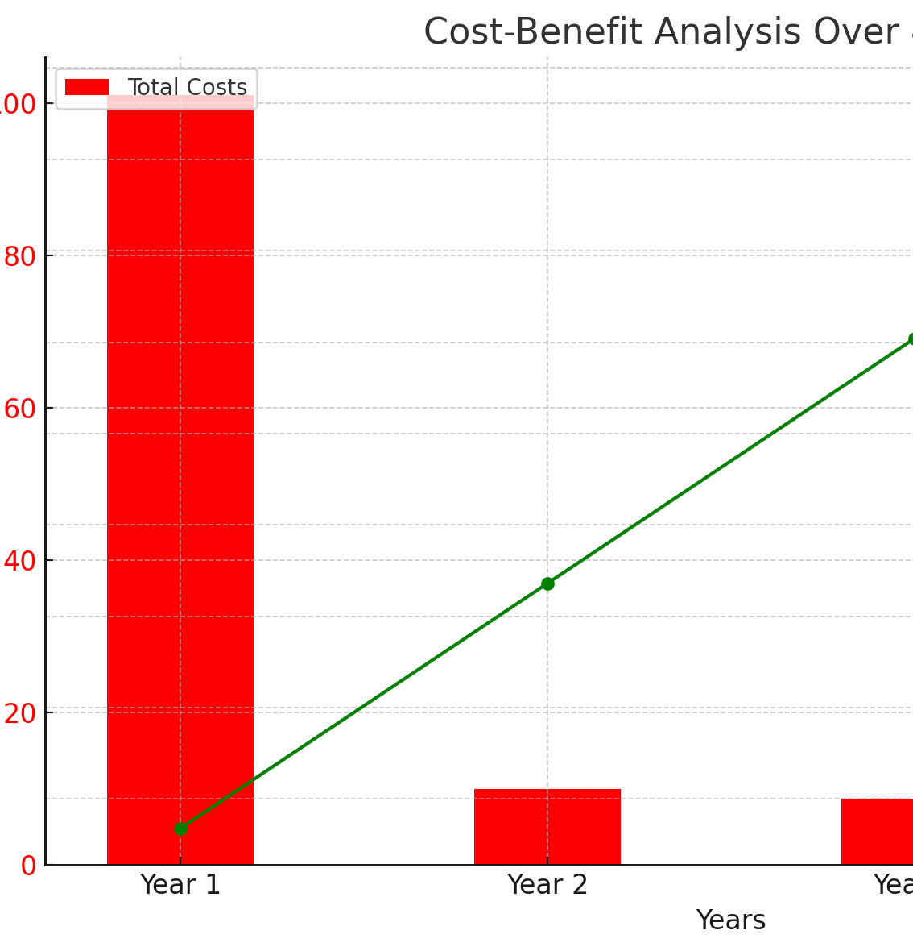
COST/BENEFITS ANALYSIS
Initial and Operational Costs
Total initial investment of $87,000,000, with major costs in software and integration, and expert services.
Operational costs projected at $14,000,000 in Year 1, focusing on training, maintenance, and additional staff.
Project Cost Overview
Total project cost over four years estimated at $128,200,000.
Largest expenses in Year 1, with significant reductions in subsequent years.
Benefit Analysis
Direct benefits include substantial increases in transaction fees and operational efficiency, totaling $67,000,000 annually.
Indirect benefits such as customer satisfaction and brand value contribute to a total of $167,500,000 over four years.
Net Benefits and ROI
Cumulative net benefits reach $240,300,000 by Year 4, despite initial costs.
Return on Investment (ROI) calculated at an impressive 187.44%.

Slide 19
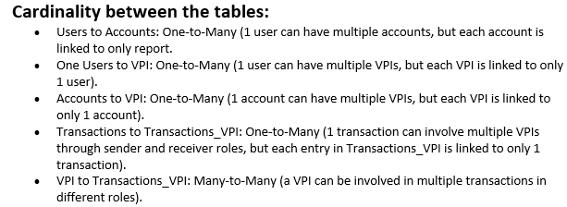
DATABASE DESIGN

Slide 20
TO-BE PROCESS DIAGRAM

Slide 21
TO BE PROCESS DESIGN
User Interaction and System Response:
Users begin the UPI transfer process via the app menu, leading to a series of system interactions including VPI creation, VPI linkage to account, and transaction initiation.
Validation and Error Handling:
The system performs critical validations at multiple stages, including checking the validity of the VPI and ensuring sufficient funds before proceeding with the transaction.
API Communication:
The process involves back-and-forth communication with the UPI API, suggesting the need for robust API integration and handling to manage data exchange and transaction authorization.
Feedback Loops:
Feedback is provided to the user at key points, such as after VPI creation, transaction initiation, and completion, ensuring transparency and user awareness throughout the transfer process.
Finalization of Transfer:
The transaction concludes with system updates, a final check for transaction completion, and a confirmation message to the user, indicating a successful UPI funds transfer.

Slide 22
REQUIRED TRANSITION REQUIREMENTS
Upgrade Infrastructure: Enhance IT systems to handle UPI protocols, ensuring they are scalable for high transaction volumes.
Compliance and Security: Align the UPI integration with financial regulations and implement strong security measures like encryption and MFA.
Extensive Testing: Conduct thorough testing across various stages, including UAT, to validate the functionality, security, and performance of the UPI system.
Stakeholder Education: Develop comprehensive training for employees and informative materials for customers to facilitate a smooth transition to UPI.
Risk Management Update: Revise the existing risk management strategies to incorporate the nuances of UPI, addressing new transaction types and potential fraud risks.

Slide 23

Monitoring and evaluating the system's performance post-implementation.
Continuously gathering customer feedback to enhance user experience.
Exploring further opportunities for digital innovation in line with market trends and customer needs.
Ensuring ongoing training and support for staff to adapt to new systems effectively.
Preparing for subsequent phases of development and expansion, based on the project's outcomes and learnings.

Slide 24


Slide 25

QUESTIONS

